Slide 1
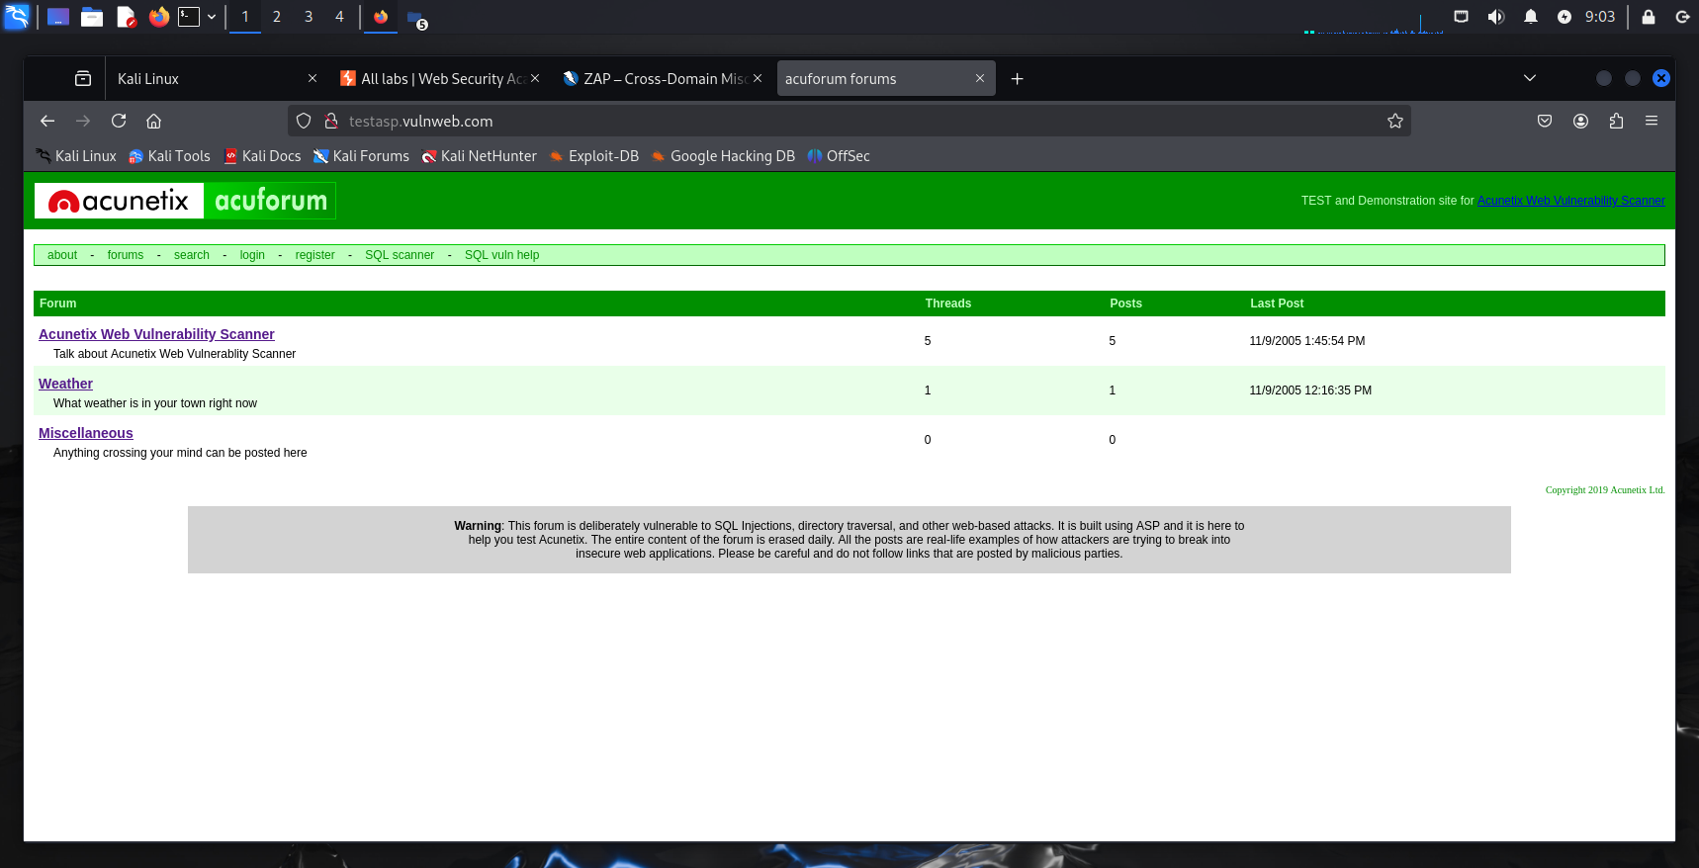
TASK 3
Domain – vulnweb.com
Subdomain – https://testasp.vulnweb.com
This Is the vulnerable website provided .

Slide 2
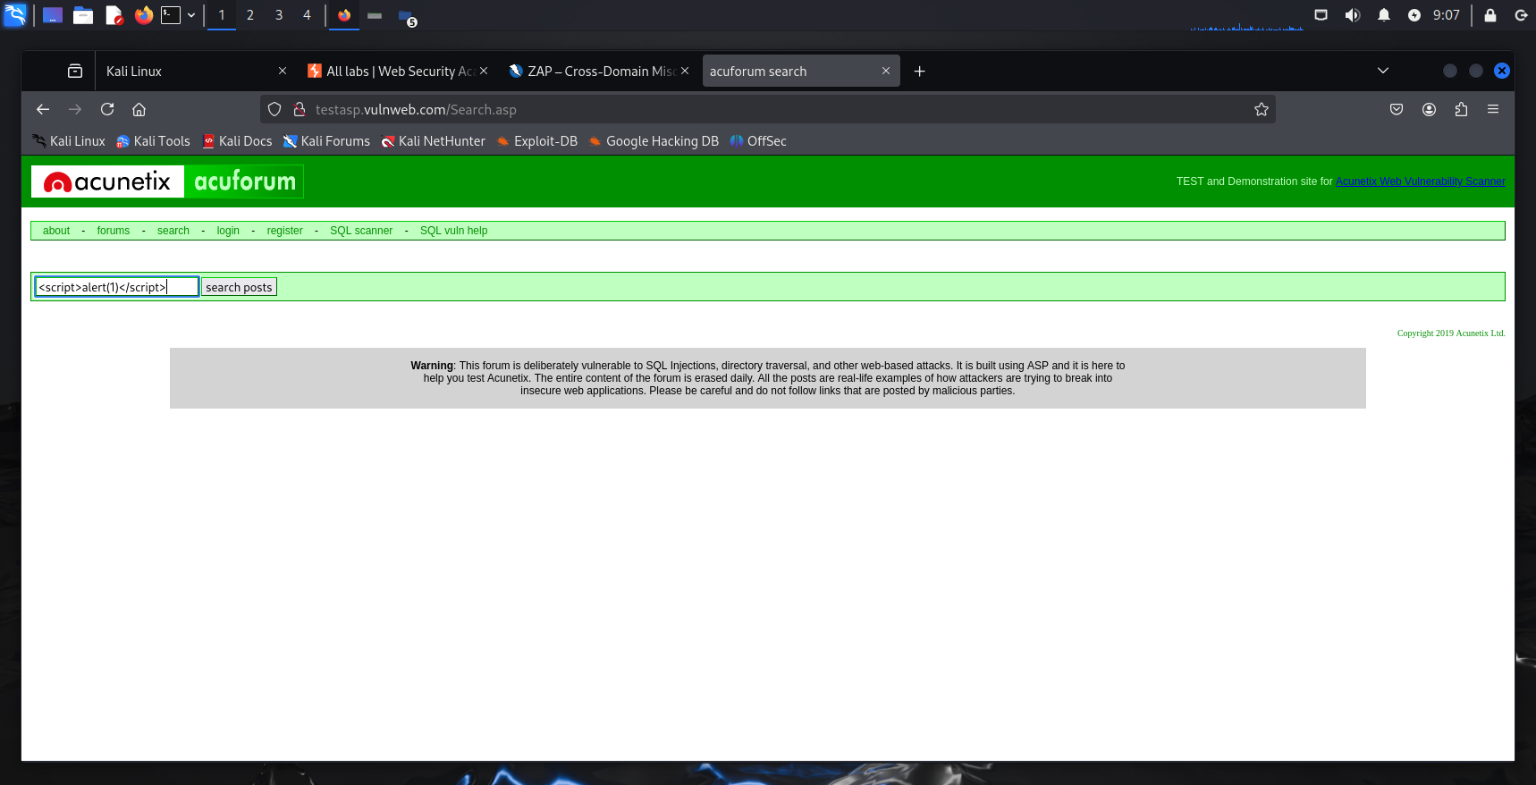
1) Vulneralibility Name : Cross-Site Scripting
Type : Reflected XSS
Severity : High
Description : The login form reflects script code back into the page . Can be used to steal session cookies , redirect users , or execute mailicious scripts .
STEPS :
1) Find a search bar or login form and enter the following payload <script>alert(1)</script> ,this is a basic payload

Slide 3
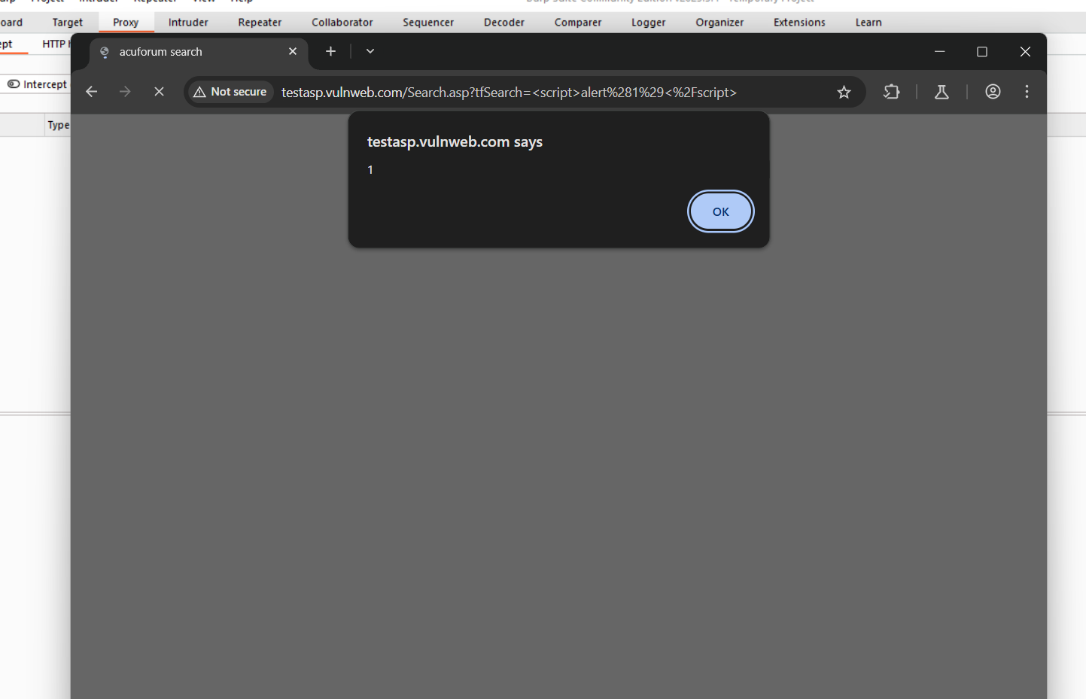
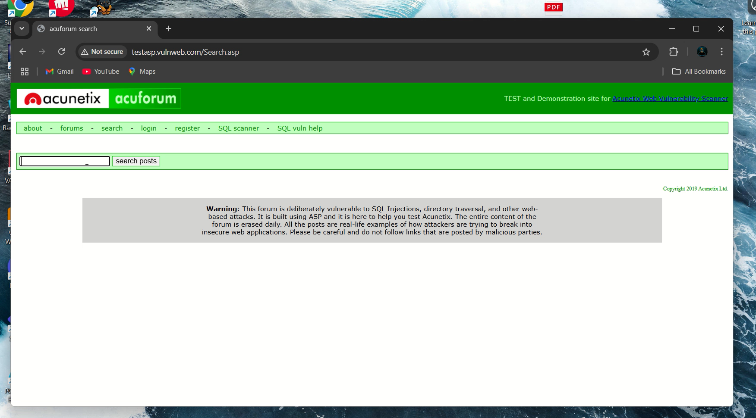
2) It’s reflecting back the message then there is a XSS vulnerability in the webpage .
← Video demonstration

Slide 4
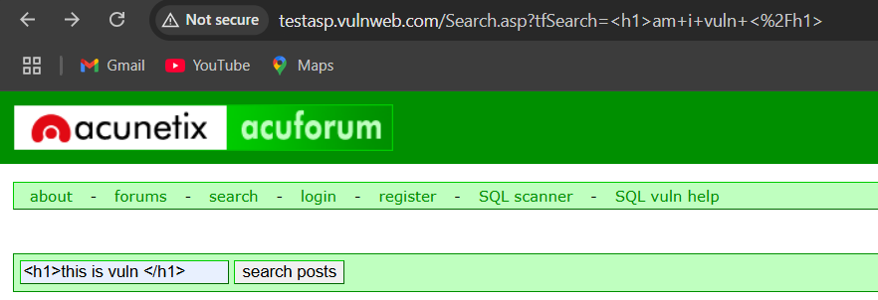
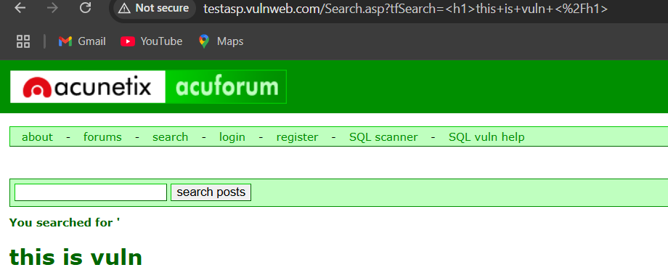
2) Vulneralibility name – HTML injection
Type : Reflected Input Injection
Severity – Medium / high
Description : The input field in the forum search function improperly handles user-supplied input , allowing raw HTML tags to be reflected and rendered back in the browser . This means that instead of sanitizing or encoding the input , the server sends it directly in the response causing the browser to interpret and display HTML .

Slide 5
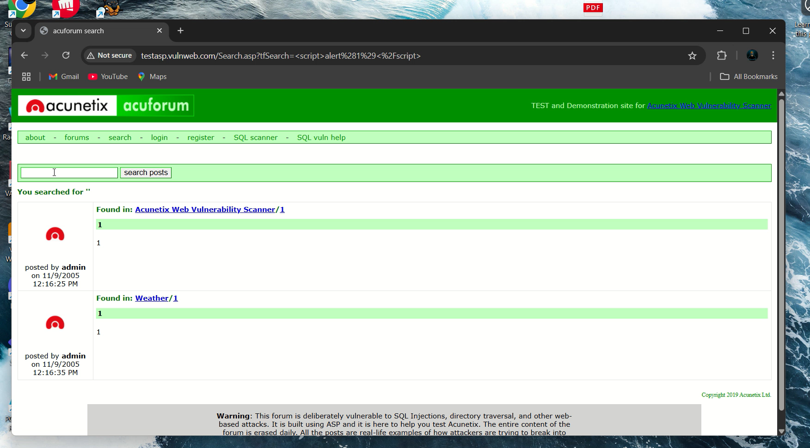
Steps :
Navigate to http://testasp.vulnweb.com/search.asp
In the search bar , enter the following payload <h1> am I vuln </h1>
Submit the input and observe that the page reflects the HTML heading instead of showing it as plain text .

Slide 6
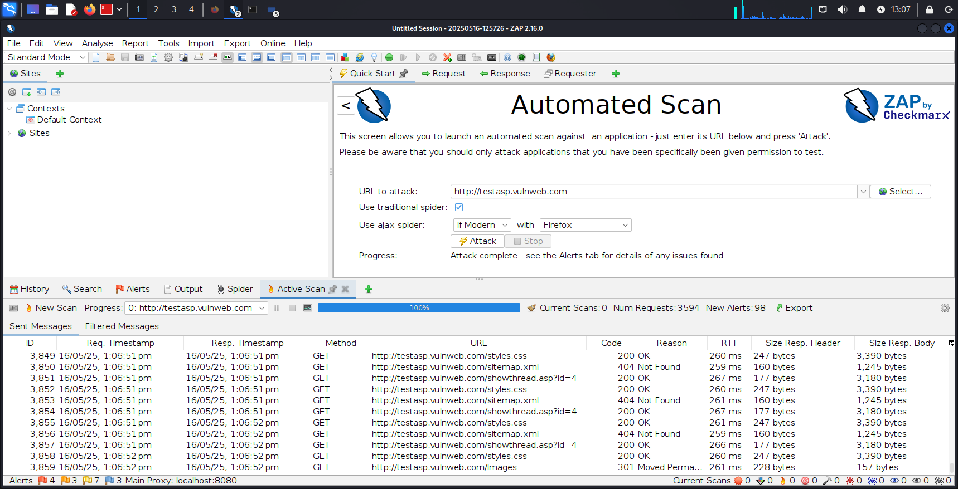
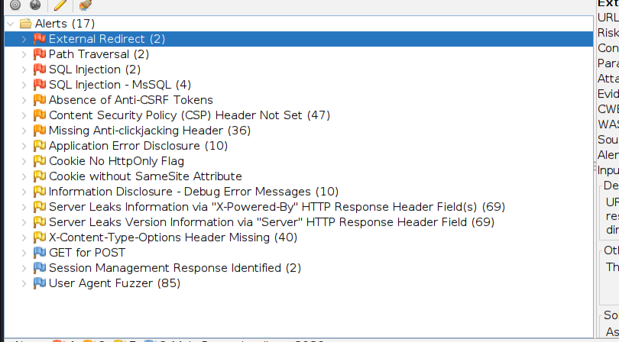
Go to ZAP from kali linux and enter URL http://testasp.vulnweb.com to attack . Now it will list the available vulneralibilities and loopholes.
These are the vulneralibilities that were reported by ZAP and an attacker can get into or mess with these vulneralibilities to leak important information .

Slide 7
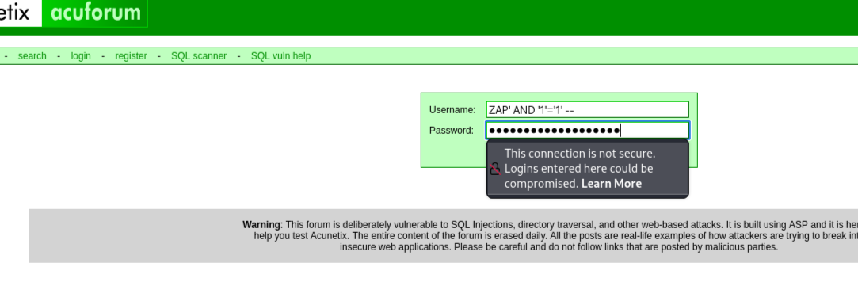
3 ) Vulnerability – SQL Injection
Severity – High
Description - This vulneralibility allows attacker to interfere with the queries of an application makes to its database . Using specially crafted input Eg. ‘OR 1=1 – an attacker can bypass authentication and manipulate the database .
Steps:
1)Open url http://testasp.vulnweb.com
2)Go to the login page .
3)Add the following zap generated payload for checking SQL injection .
4) I have attached video demonstration by which the payloads used by ZAP caused one user to login to an uncreated account confirming the injection point .

Slide 8
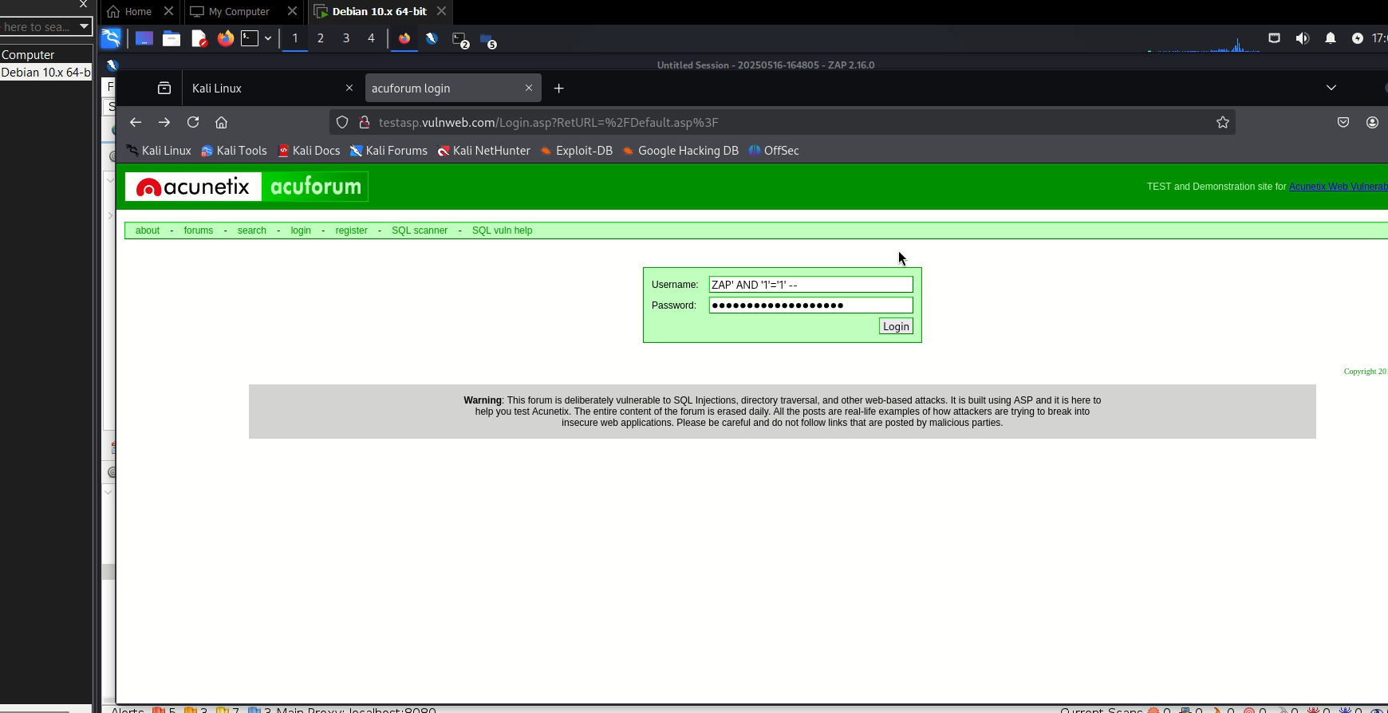
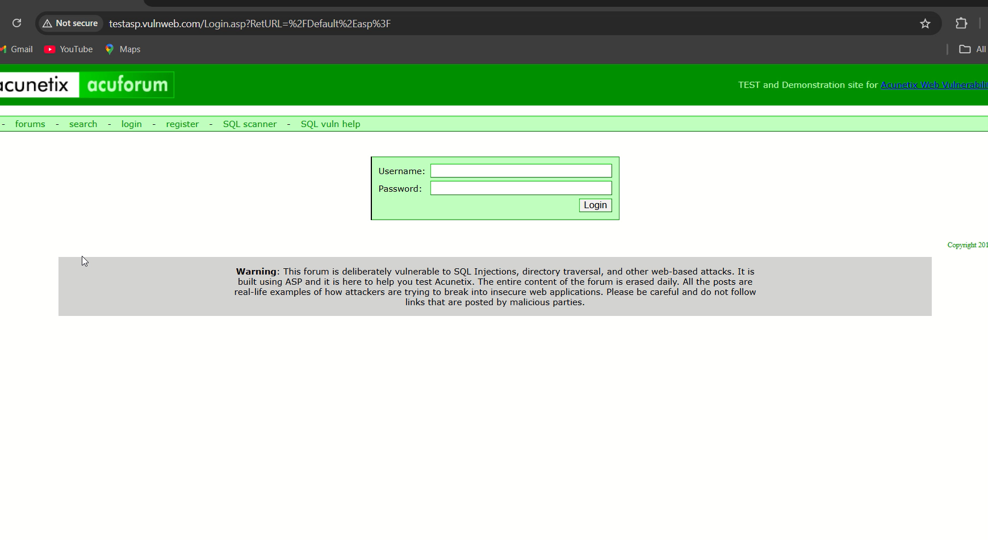
In the first video you can see using payload ZAP’ AND ‘1’=‘1’ – as username and password allowed me to login into an account .
In this video you would see that after using payload ZAP’ WAITFOR DELAY ‘0:0:15’ – the webpage freezes for 15 secs and then logs in to the account showing SQL injection .

Slide 9
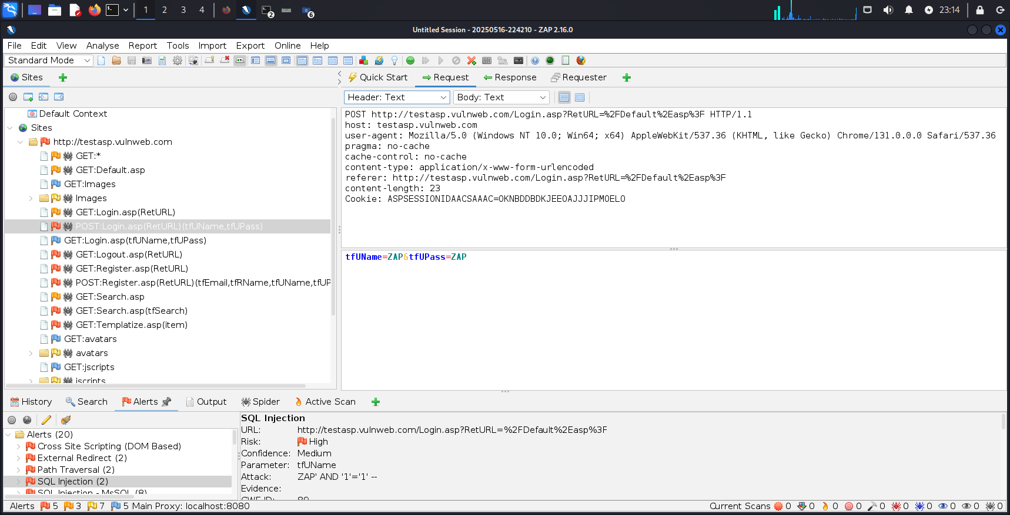
4) Vulneralibility – Absence of anti CSRF token
Severity – Medium
Description – cross site request forgery tricks the victim into submitting a request unknowingly . Apps prevent this using CSRF tokens .
Steps :
go to ZAP and then sites and enter the target domain .
Find for form based requests such as post ( login.asp or register.asp)
Inspect the request body
Check for a hidden input like <input type="hidden" name="csrf_token" value="abc123">
If no such input / token found it is most likely missing proper CSRF protection.

Slide 10
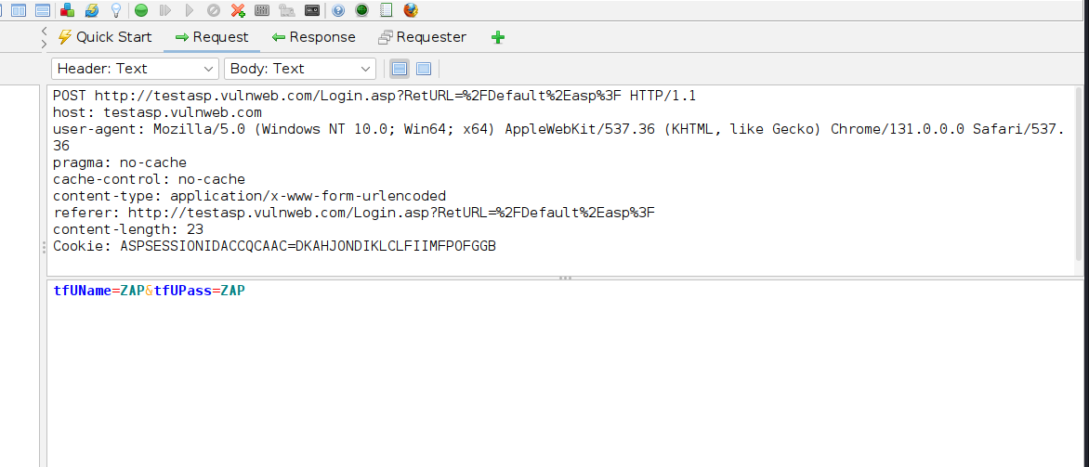
As you can see in the request box there is no presence of a CSRF token thus this is a vulneralibility .
.
5) Vulneralibility – Cookie without HTTP only flag
Risk – Medium
Description – the HTTPonly attribute in cookies helps mitigate XSS attacks . When the flag is not set the cookie can be accessed by Javascript leading to session theft.

Slide 11
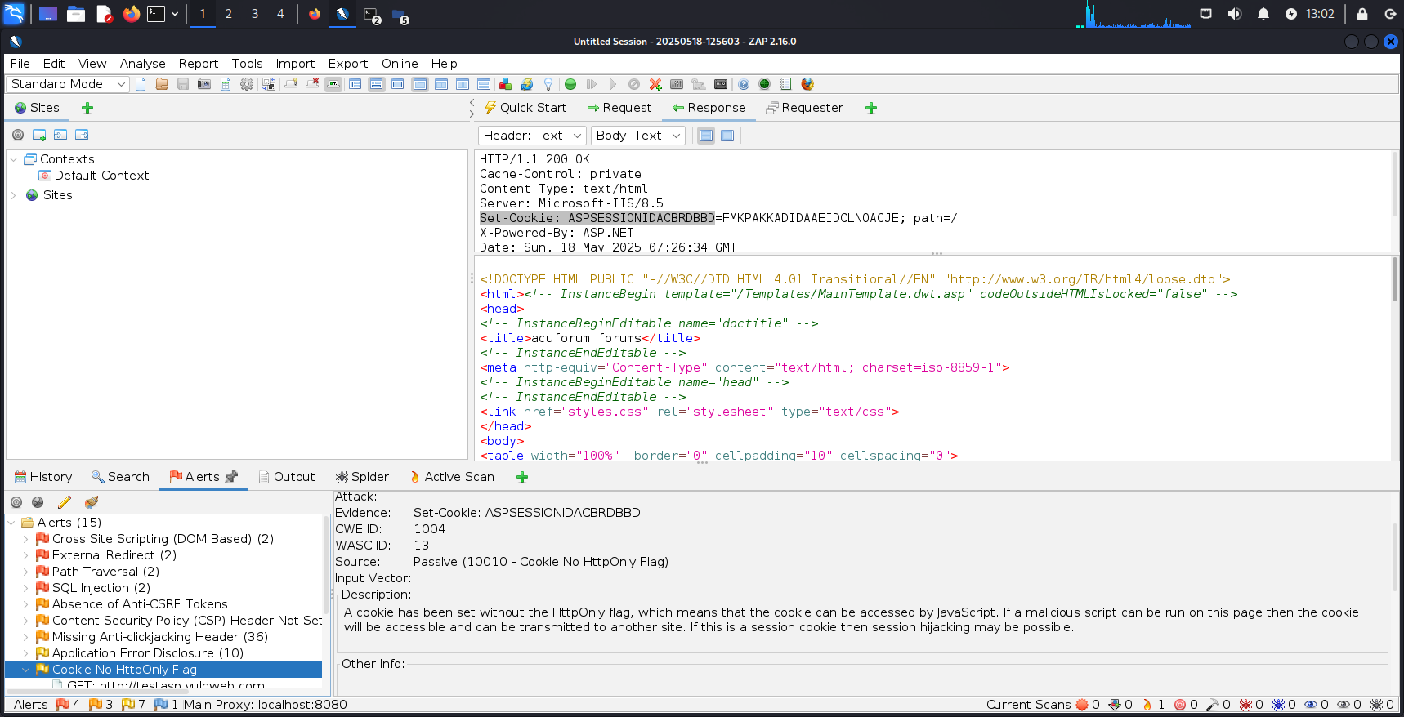
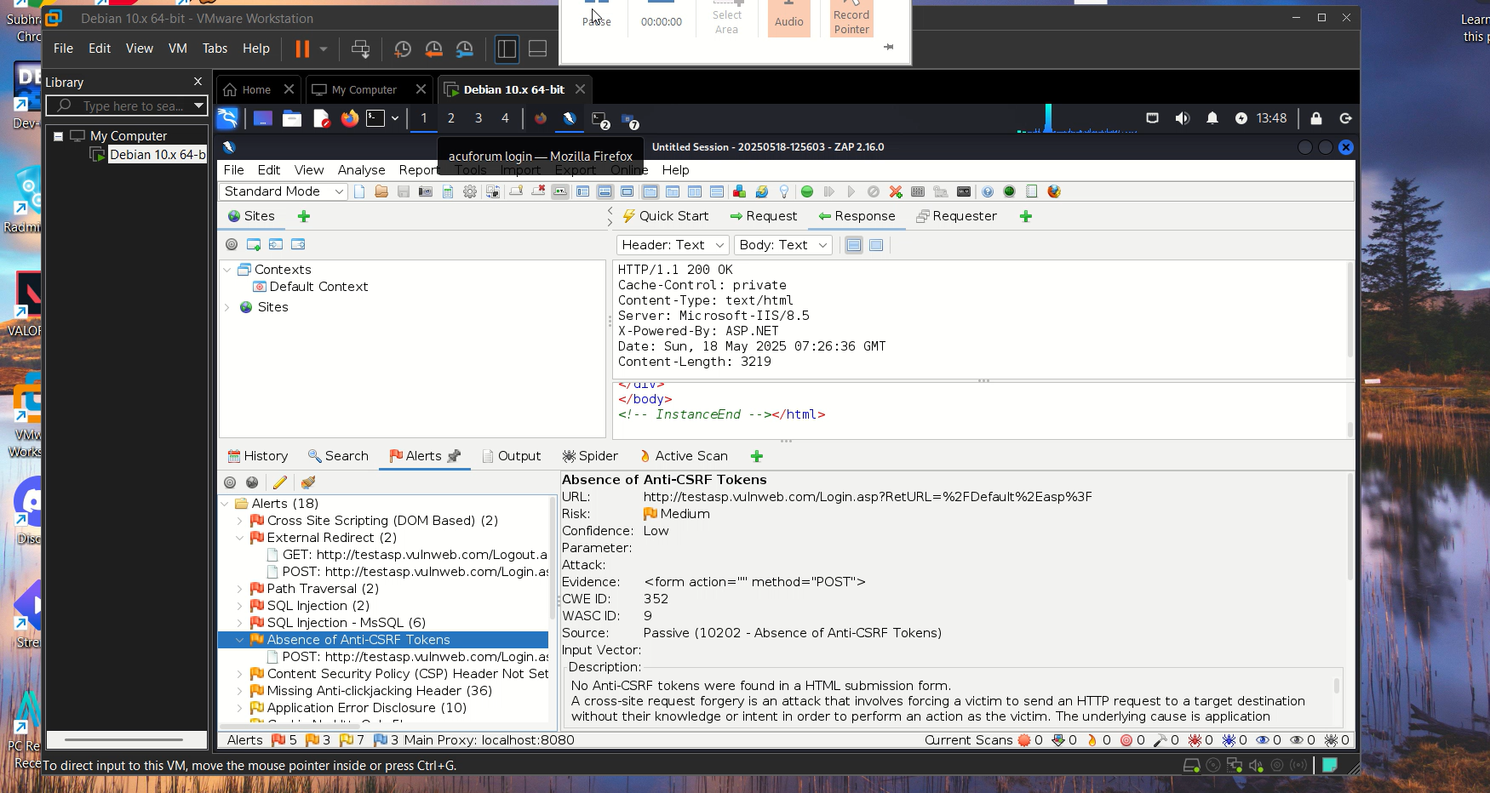
Steps :
Go to your browser and search http://testasp.vulnweb.com
Look for search box , login pages , register etc
Now open the ZAP tab and alerts where you can see the No HTTPonly flag
← Video demonstration

Slide 12
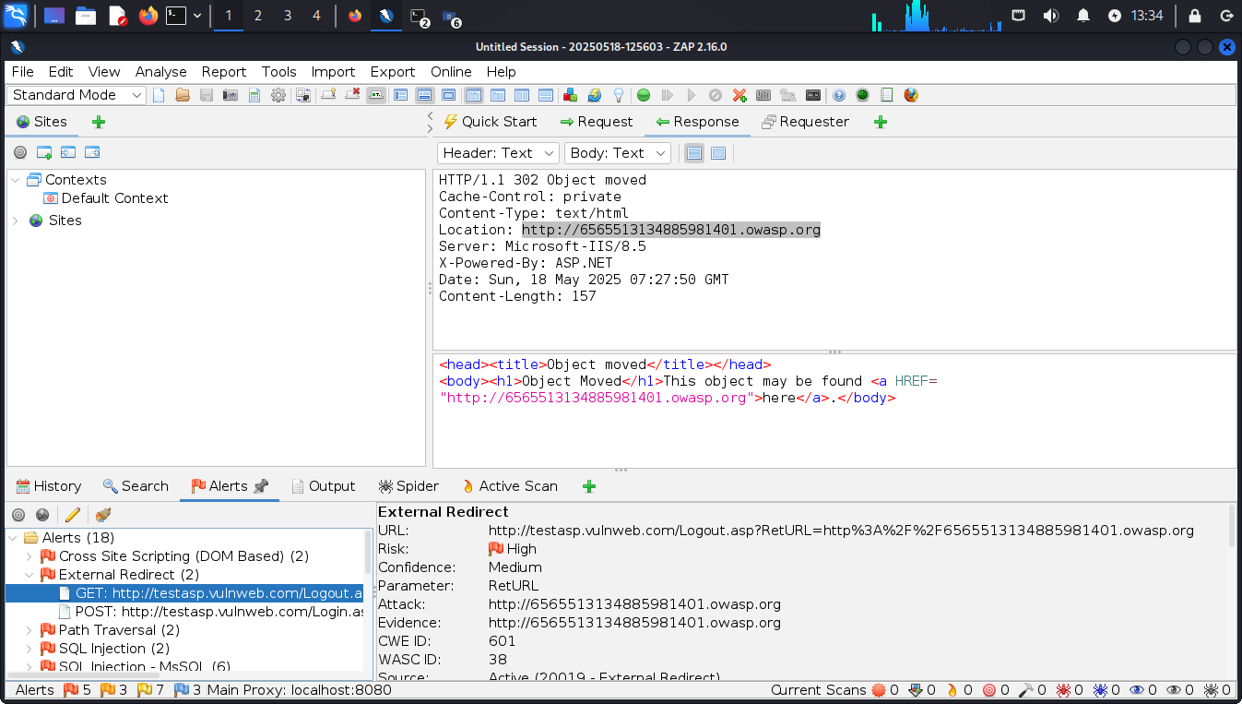
6) Vulneralibility – External Redirect
Severity – High
Desciption – An external redirect vulneralibilty occurs when a web application redirects users to an external URL without properly validating the destination . Attackers can exploit it to trick users into visiting malicious websites , carry out phishing attacks , redirect victim after login to steal credentials .
Steps :
1) go to a login page or search bar in testasp.vulnweb.com
2) Replace ReturnURL part in http://testasp.vulnweb.com/Login.asp?RetURL=http://evil.com or any domain where you want to take the user to
3) Send the request and now check the response headers it the location gets moved to http://evil.com then it is vulnerable .

